Slide 1
Reading and Writing in Python
Lesson 3.2

Slide 2
Class Objectives
By the end of today’s class, you will be able to:
Read data into Python from CSV files.
Write data from Python to CSV files.
Zip two lists together and know when this is helpful.
Create and use Python functions.

Slide 3
Activity: Python Check-Up
Let’s start with a quick warm-up activity to get the Python juices flowing!
10 minutes

Slide 4
Activity: Python Check-Up
Create a simple Python command line application that does the following:
Prints “Hello User!”
Then asks “What is your name?”
Then responds “Hello <user’s name>”
Then asks “What’s your favorite number?”
Then responds: "Your favorite number is lower than mine.", "Your favorite number is higher than mine.", or "Your favorite number is the same as mine!" depending on your favorite number.

Slide 6
Loop Recap

Slide 7
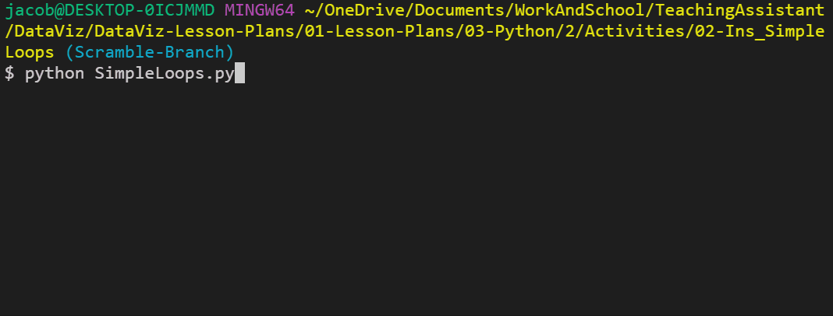
What Is a for Loop?
Loops through a range of numbers, the letters in a string, or the elements within a list one by one.

Slide 8
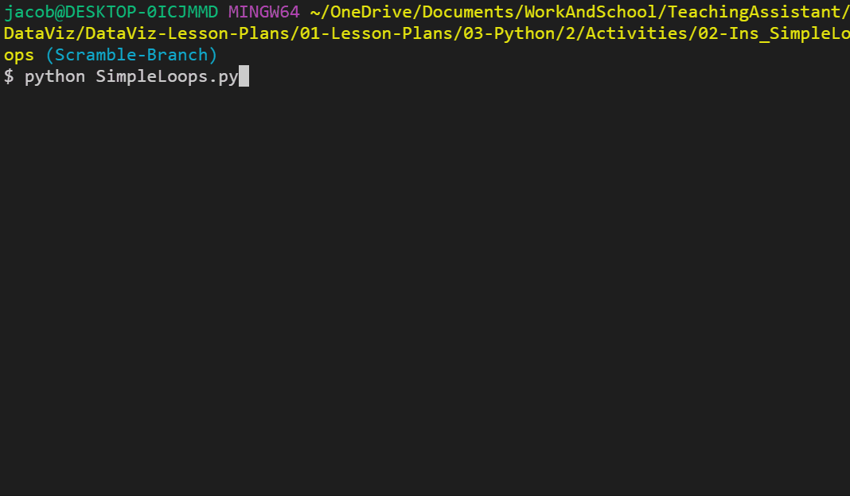
What Is a while Loop?
Loops through the code contained inside of it until some condition is met.

Slide 10
Activity: Kid in a Candy Store
In this activity, you will create the code that a candy store will use in their state-of-the-art candy vending machine.
15 minutes

Slide 11
Activity: Kid in a Candy Store
Instructions | Create a loop that prints all of the candies in the store to the terminal, with their index stored in brackets beside them. For example: "[0] Snickers"
 | Create a second loop that runs for a number of times determined by the variable allowance. For example: If allowance is equal to five, the loop should run five times.
 | Each time this second loop runs, take in a user's input, preferably a number, and then add the candy with a matching index to the variable candy_cart. For example: If the user enters "0" as their input, "Snickers" should be added into the candy_cart list.
 | Use another loop to print all of the selected candies to the terminal.
Bonus | Create a version of the code that allows a user to select as much candy as they want, up until they say they do not want any more.

Slide 13
Activity: House of Pies
In this activity, you will build an order form that displays a list of pies and then prompts users to make a selection. It will continue to prompt for selections until the user decides to end the process.
20 minutes

Slide 14
Activity: House of Pies
Part 1 instructions:
Create an order form that displays a list of pies to the user in the following way:
Welcome to the House of Pies Here are our pies:
_______________________________________________________________
(1) Pecan, (2) Apple Crisp, (3) Bean, (4) Banoffee, (5) Black Bun, (6) Blueberry, (7) Buko, (8) Burek
Then, prompt the user to enter the number for the pie they'd like to order.
Immediately follow up their order with Great! We’ll have that <PIE NAME> right out for you, and then ask if they would like to make another order. If so, repeat the process
Once the user is done purchasing pies, print the total number of pies ordered.

Slide 15
Activity: House of Pies
Bonus: Modify the application so that at the conclusion of the transaction, the user's purchases are listed out, with the total pie count broken by each pie. For example:
You purchased:
0 Pecan
0 Apple Crisp
0 Bean
2 Banoffee
0 Black Bun
0 Blueberry
0 Buko
0 Berek
0 Tamale
1 Steak

Slide 17
Reading Text Files

Slide 18
Python can read in data from external text files and then perform tasks on that data.

Slide 19
Reading Text Files
We all need directions to go from point A to point B, and Python is no different when dealing with external files. It requires very precise directions about what path to follow to reach the desired file.
In this case, the desired file is located within a subfolder called “Resources,” so the path we need to provide Python would be “Resources/FileName.txt”.
Note: Different operating systems set their paths in different ways.
# Store the file path associated with the file (note the backlash may be OS specific)
file = 'Resources/input.txt'

Slide 20
Reading Text Files
with is a special syntax block that allows us to perform operations that require a safety clean-up after the code block is completed.
open<File Path>, <Read/Write> is the function that Python uses to open a file. By specifying either 'r', 'w', or 'rw', we can read from a text file, write to a text file, or perform both operations.
text.read() reads the entire file and converts it to a string type.
# Open the file in "read" mode ('r') and store the contents in the variable "text"
with open(file, 'r') as text:
# Store all of the text inside a variable called "lines"
lines = text.read()
# Print the contents of the text file
print(lines)

Slide 21
Introduction to Modules

Slide 22
No built-in function for my specific task? Don’t worry! We can bring in external modules to perform the specific task.

Slide 23
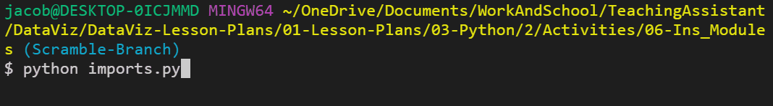
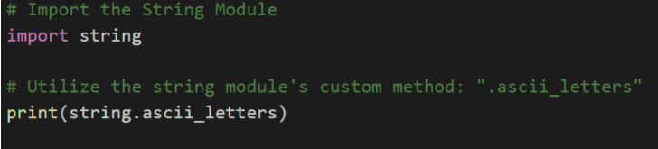
Introduction to Modules
Import Modules
The string module contains many helpful constants and methods that pertain to strings. For example, we can use string.ascii_letters, and Python will instantly grab a reference to every ASCII character.

Slide 24
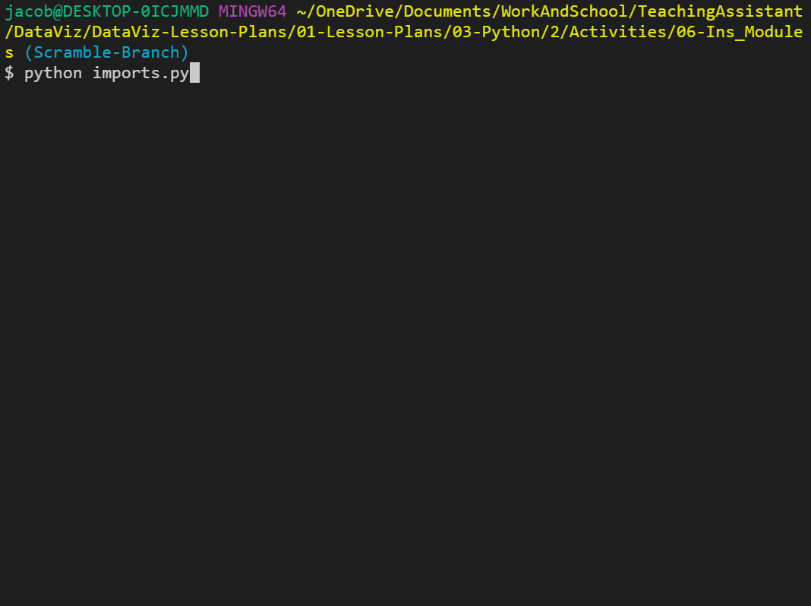
Introduction to Modules
Import Modules
The random module does exactly what we might expect: it allows Python to randomly select values from set ranges, lists, or even strings.

Slide 26
Activity: Module Playground
In this activity, you will explore some Python modules.
5 minutes

Slide 27
Activity: Module Playground
Instructions | There are tons of built-in modules for Python, and there is no possible way that a single class could cover all of them.
 | Take a moment to explore a built-in Python module, then share what you uncovered.
Hint | Use your expert Google skills!

Slide 29
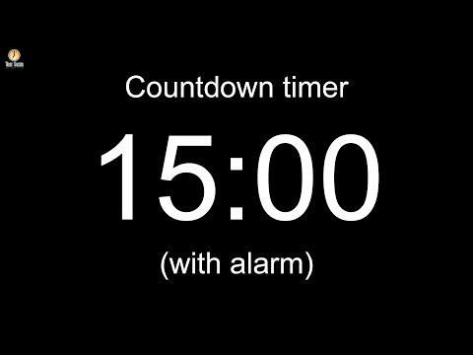

Slide 30
Reading in CSV Files

Slide 31
In the data industry, you’ll encounter files known as CSV files.

Slide 32
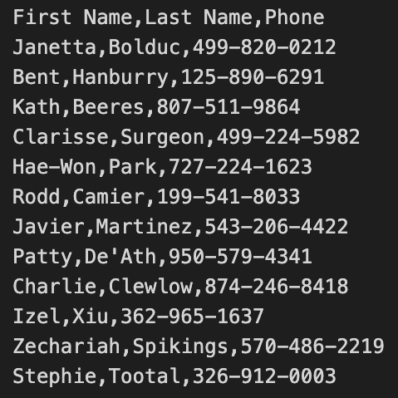
Reading in CSV Files
Comma Separated Values
CSV stands for comma separated values. This file type is essentially a table that has been converted into text format with each row and column separated by specified symbols.
More often than not, each row is located on a new line, and each column is separated by a comma, as indicated in the name “CSV.”

Slide 33
Python has a module called csv that pulls in data from external CSV files and allows users to perform operations on the data.

Slide 34
Reading in CSV Files
os module
This module allows Python programmers to easily create dynamic paths to external files that will function across different operating systems.
# First we’ll import us module
# This will allow us to create file path across operating systems
import os
# Module for reading CSV files
import csv
csvpath = os.path.join('..', 'Resources', 'contacts.csv')

Slide 35
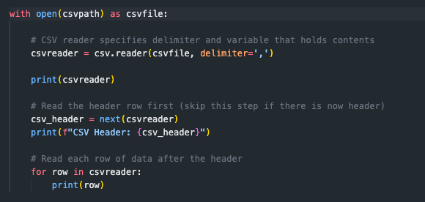
Reading in CSV Files
csv reader
Instead of text.read(), this new code instead utilizes csv.reader() to translate the object being opened by Python. Note the delimiter=',' parameter, which tells Python that each comma within the CSV should be seen as moving into a new column for a row.

Slide 37
Activity: Reading Comic Book Data
In this activity, you will create an application that searches the provided CSV file for a specific graphic novel title and then returns the title, publisher’s name, and the year it was published.
15 minutes

Slide 38
Activity: Reading Comic Book Data
Instructions | Prompt the user for the book title they’d like to search.
 | Search through the comic_books.csv to find the user's book.
 | If the CSV contains the user's book, then print out the title, the publisher’s name, and the year it was published. For example: 'Alien was published by DC Comics in 2015'
 | If the CSV does not contain the user’s title, then print out a message telling then that their book could not be found. Set a variable to False to check if we found the comic book. In the for loop, change the variable to confirm that the comic book is found.

Slide 40
Writing CSV Files

Slide 41
We all know Python can read in data from CSVs. Next, we’ll write data to a CSV!

Slide 42
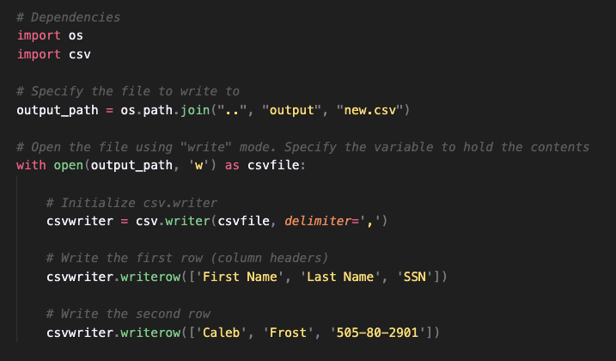
Writing CSV Files
Lost in Translation?
os.path.join("..", "output", "new.csv") tells Python the file to write to while assigning it to the variable output_path.
with open(output_path, 'w') as csvfile: tells Python to open the file by using write mode, while holding the contents in output_path.
csv.writer() tells Python that this application will write code into an external CSV file.
csv.writerow() is the code to write a new row into a CSV file.

Slide 43
Zipping Lists

Slide 44
Python users can write data into a new CSV file more efficiently by using the zip() function.

Slide 45
Zipping Lists
zip() takes in a series of lists as its parameters and joins them together in a stack.
By zipping these lists together, there is now a single, joined list whose indexes reference all three of the lists inside.
Each zipped object can be used only once. For example, you can write the zipped object to a CSV or print to the terminal, but not both.
# Three Lists
indexes = [1, 2, 3, 4]
employees = ["Micheal", "Dwight", "Meredith", "Kelly"]
department = ["Boss", "Sales", "Sales", "HR"]
# Zip all three lists together into tuples
roster = zip(indexes, employees, department)
# Print the contents of each row
for employees in roster:
print(employee)
$ python zipper.py
(1, 'Micheal', 'Boss')
(2, 'Dwight', 'Sales')
(4, 'Meredith', 'Sales')
(4, 'Kelly', 'HR')

Slide 47
Activity: U.S. Census Zip
In this activity, you will be provided with a large dataset from the 2019 U.S. Census. Your task is to clean up this dataset and create a new CSV file that is easier to comprehend.
20 minutes

Slide 48
Activity: U.S. Census Zip
Instructions | Hints | Bonus
Create a Python application that reads in the data from the 2019 U.S. Census. Then, store the contents of Place, Population, Per Capita Income, Number of Reviews, and Poverty Count into Python Lists. Then, zip these lists together into a single tuple. Finally, write the contents of your extracted data into a CSV. Make sure to include the titles of these columns in your CSV. | Windows users may get a UnicodeDecodeError. To avoid this, pass in encoding=cutf8 as an additional parameter when reading in the file. As with many datasets, the file does not include the header line. Use the following list as a guide to the columns: "Place, Population, Median Age, Household Income, Per Capita Income, Employed Civilians, Unemployed Civilians, People in the Military, Poverty Count" | Find the poverty rate (percentage of the population living in poverty). Include this in your final output, converting the rate to a string and including a '%' at the end of the string. Parse the string associated with Place, separating it into County and State, so we can store both in separate columns.

Slide 50
Introduction to Functions

Slide 51
DRY stands for Don’t Repeat Yourself, which is a popular acronym that many coders live by.

Slide 52
Introduction to Functions
Prevent repetition with frequent use of Python functions.
A function is a block of organized, reusable code that is used to perform a single, related action. In other words, functions are placeable blocks of code that perform a specific action.
To create a new function, simply use def <FUNCTION NAME>():, and then place the code that you would like to run within the block underneath it.
To run the code stored within a function, the function itself must be called within the program. Functions will not run unless called upon.
Functions that take in parameters can also be created by simply adding a variable into the parentheses of the function's definition. This allows specific data to be passed into the function.
def print_hello():
print(f"Hello!")
print_hello()
def print_name(name):
print("Hello " + name + "!")
print_name("Bob Smith")

